Slide 1
Evaluasi Akhir Semester Analisis Jaringan
Dikumpulkan Selasa 14/12/2021 jam 23:59
Oleh : A M Hawali Akbar
NRP : 07111840000102

Slide 2
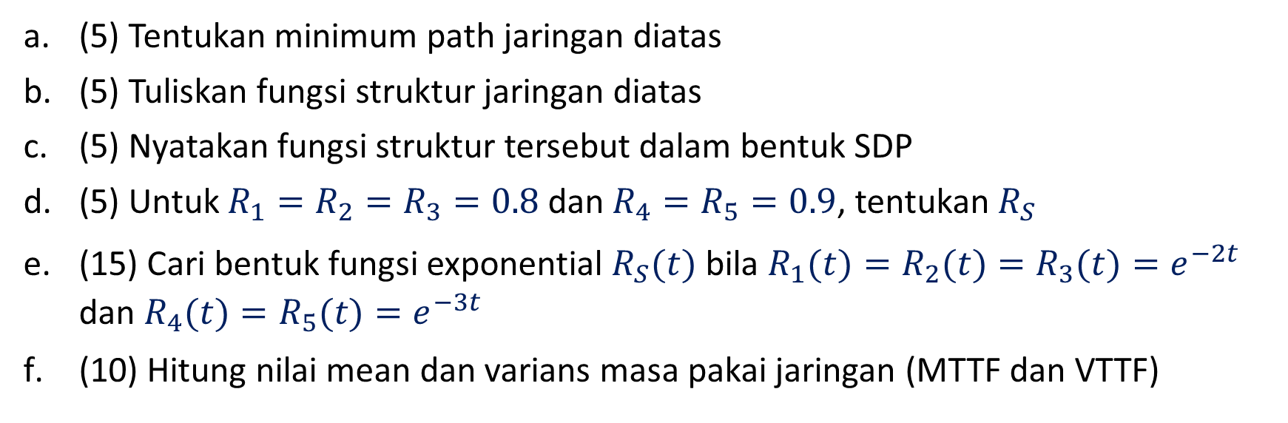
1. Untuk jaringan berikut
3
1
5
4
2
(5) Tentukan minimum path jaringan diatas
(5) Tuliskan fungsi struktur jaringan diatas
(5) Nyatakan fungsi struktur tersebut dalam bentuk SDP
(5) Untuk $R_{1}=R_{2}=R_{3}=0.8$ dan $R_{4}=R_{5}=0.9$, tentukan $R_{S}$
(15) Cari bentuk fungsi exponential $R_{S}(t)$ bila $R_{1}(t)=R_{2}(t)=R_{3}(t)=e^{−2t}$ dan $R_{4}(t)=R_{5}(t)=e^{−3t}$
(10) Hitung nilai mean dan varians masa pakai jaringan (MTTF dan VTTF)

Slide 3
Jawaban No 1a
Dari soal, diperoleh source dan sink dari jaringan kemudian diubah ke bentuk bridge, sebagai berikut.
3
1
3
Source
1
Sink
5
4
5
Source
Sink
2
2
4

Slide 4
Jawaban No 1a
1
3
Dari source dan sink tersebut ditentukan minimum pathnya, sebagai berikut.
Minimum Path : {1,3},{1,5,4}, {2,4}
5
Source
Sink
2
4

Slide 5
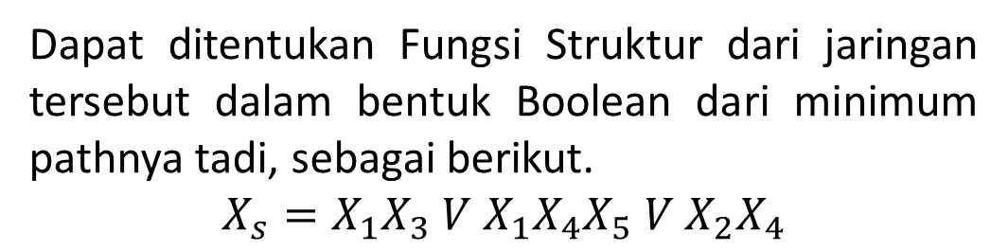
Jawaban No 1b
3
Dapat ditentukan Fungsi Struktur dari jaringan tersebut dalam bentuk Boolean dari minimum pathnya tadi, sebagai berikut.
$$X_{s}=X_{1}X_{3} V X_{1}X_{4}X_{5} V{ X}_{2}X_{4}$$
1
5
4
2

Slide 6
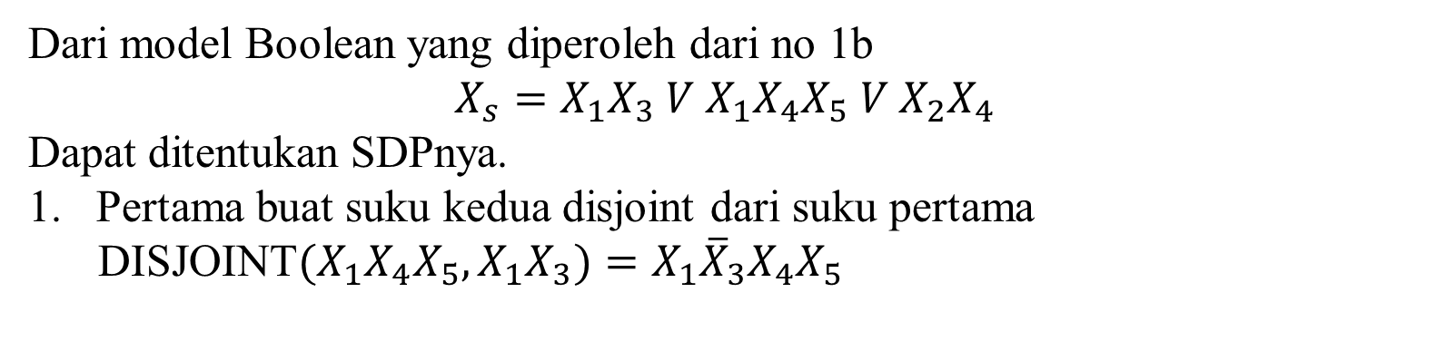
Jawaban No 1c
Dari model Boolean yang diperoleh dari no 1b
$$X_{s}=X_{1}X_{3} V X_{1}X_{4}X_{5} V{ X}_{2}X_{4}$$
Dapat ditentukan SDPnya.
Pertama buat suku kedua disjoint dari suku pertama
DISJOINT$(X_{1}X_{4}X_{5},X_{1}X_{3})=X_{1}{\overline{X}}_{3}X_{4}X_{5}$

Slide 7
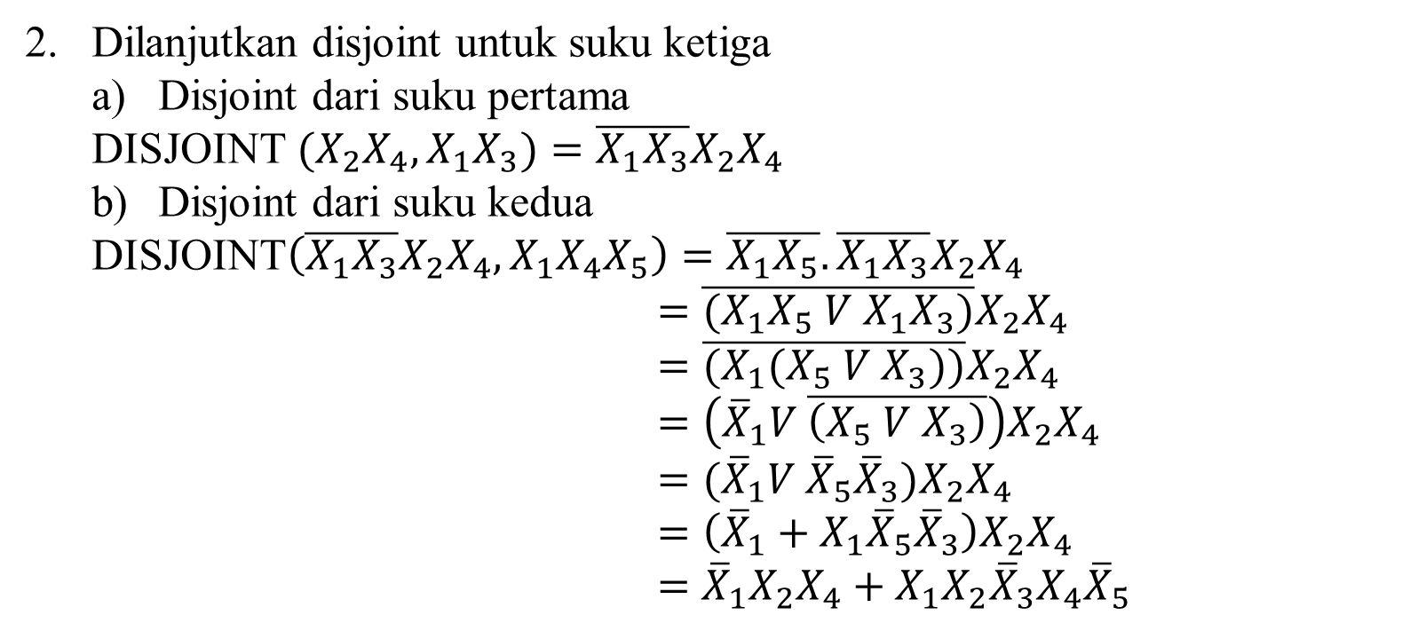
Jawaban No 1c
Dilanjutkan disjoint untuk suku ketiga
Disjoint dari suku pertama
DISJOINT $(X_{2}X_{4},X_{1}X_{3})=\overline{X_{1}X_{3}}X_{2}X_{4}$
Disjoint dari suku kedua
DISJOINT$\left(\overline{X_{1}X_{3}}X_{2}X_{4},X_{1}X_{4}X_{5}\right)=\overline{X_{1}X_{5}}.\overline{X_{1}X_{3}}X_{2}X_{4}$
$=\overline{{(X}_{1}X_{5} V{ X}_{1}X_{3})}X_{2}X_{4}$
$=\overline{{(X}_{1}(X_{5} V{ X}_{3}))}X_{2}X_{4}$
$=\left({\overline{X}}_{1}V \overline{\left(X_{5} V{ X}_{3}\right)}\right)X_{2}X_{4}$
$=({\overline{X}}_{1}V{ \overline{X}}_{5}{\overline{X}}_{3})X_{2}X_{4}$
$=\left({\overline{X}}_{1}+{X_{1}\overline{X}}_{5}{\overline{X}}_{3}\right)X_{2}X_{4}$
$=$ ${\overline{X}}_{1}X_{2}X_{4}+{X_{1}X_{2}{\overline{X}}_{3}X_{4}\overline{X}}_{5}$

Slide 8
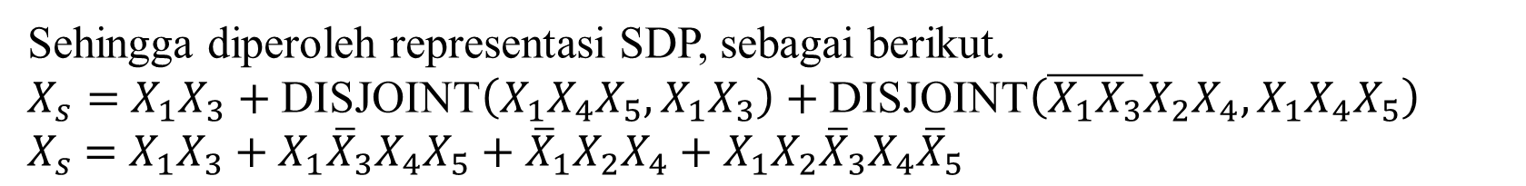
Jawaban No 1c
Sehingga diperoleh representasi SDP, sebagai berikut.
$X_{s}=$ $X_{1}X_{3}+\text{DISJOINT}\left(X_{1}X_{4}X_{5},X_{1}X_{3}\right)+\text{DISJOINT}\left(\overline{X_{1}X_{3}}X_{2}X_{4},X_{1}X_{4}X_{5}\right)$
$X_{s}$ $=$ $X_{1}X_{3}+X_{1}{\overline{X}}_{3}X_{4}X_{5}+{\overline{X}}_{1}X_{2}X_{4}+{X_{1}X_{2}{\overline{X}}_{3}X_{4}\overline{X}}_{5}$

Slide 9
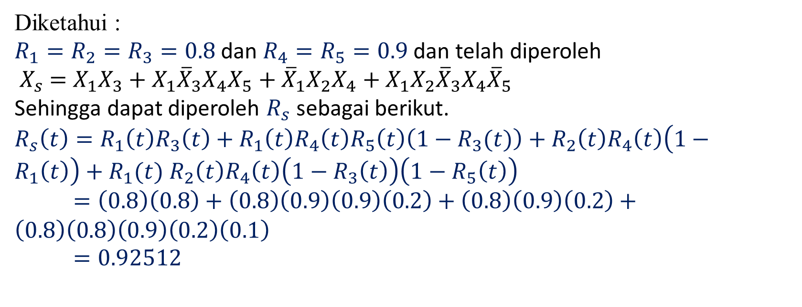
Jawaban No 1d
Diketahui :
$R_{1}=R_{2}=R_{3}=0.8$ dan $R_{4}=R_{5}=0.9$ dan telah diperoleh
$X_{s}$ $=$ $X_{1}X_{3}+X_{1}{\overline{X}}_{3}X_{4}X_{5}+{\overline{X}}_{1}X_{2}X_{4}+{X_{1}X_{2}{\overline{X}}_{3}X_{4}\overline{X}}_{5}$
Sehingga dapat diperoleh $R_{s}$ sebagai berikut.
$R_{s}\left(t\right)=R_{1}\left(t\right)R_{3}\left(t\right)+R_{1}\left(t\right)R_{4}\left(t\right)R_{5}\left(t\right)\left(1−R_{3}(t)\right)+R_{2}\left(t\right)R_{4}\left(t\right)\left(1−R_{1}\left(t\right)\right)+R_{1}(t)$ $R_{2}\left(t\right)R_{4}\left(t\right)\left(1−R_{3}\left(t\right)\right)\left(1−R_{5}\left(t\right)\right)$
$=\left(0.8\right)\left(0.8\right)+\left(0.8\right)\left(0.9\right)\left(0.9\right)\left(0.2\right)+\left(0.8\right)\left(0.9\right)\left(0.2\right)+\left(0.8\right)\left(0.8\right)\left(0.9\right)\left(0.2\right)\left(0.1\right)$
$=0.92512$

Slide 10
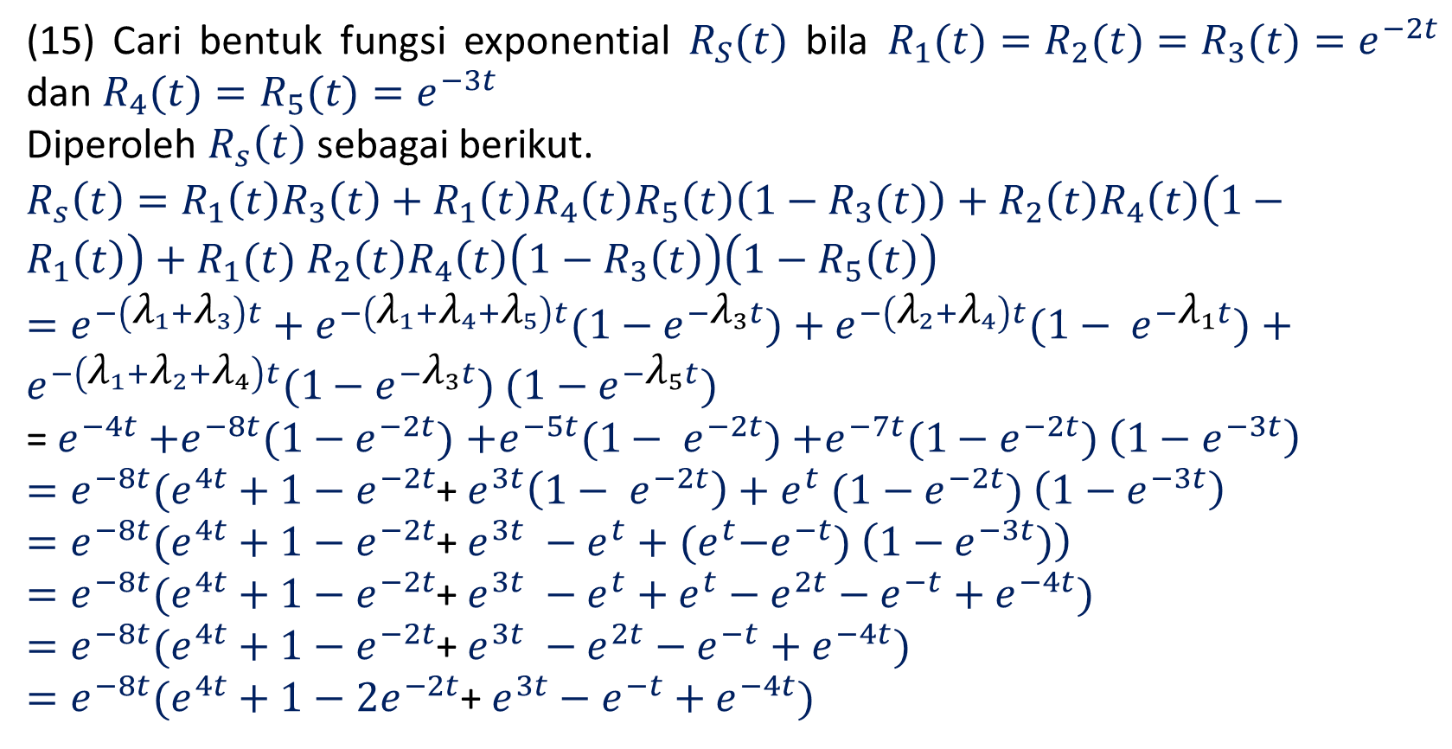
Jawaban No 1e
(15) Cari bentuk fungsi exponential $R_{S}(t)$ bila $R_{1}(t)=R_{2}(t)=R_{3}(t)=e^{−2t}$ dan $R_{4}(t)=R_{5}(t)=e^{−3t}$
Diperoleh $R_{s}\left(t\right)$ sebagai berikut.
$R_{s}\left(t\right)=R_{1}\left(t\right)R_{3}\left(t\right)+R_{1}\left(t\right)R_{4}\left(t\right)R_{5}\left(t\right)\left(1−R_{3}(t)\right)+R_{2}\left(t\right)R_{4}\left(t\right)\left(1−R_{1}\left(t\right)\right)+R_{1}(t)$ $R_{2}\left(t\right)R_{4}\left(t\right)\left(1−R_{3}\left(t\right)\right)\left(1−R_{5}\left(t\right)\right)$
$=e^{−\left({\text{λ}}_{1}+{\text{λ}}_{3}\right)t}+e^{−\left({\text{λ}}_{1}+{\text{λ}}_{4}+{\text{λ}}_{5}\right)t}(1−e^{−{\text{λ}}_{3}t})+e^{−\left({\text{λ}}_{2}+{\text{λ}}_{4}\right)t}(1− e^{−{\text{λ}}_{1}t})+e^{−\left({\text{λ}}_{1}+{\text{λ}}_{2}+{\text{λ}}_{4}\right)t}(1−e^{−{\text{λ}}_{3}t})$ $(1−e^{−{\text{λ}}_{5}t})$
= $e^{−4t}$ $+e^{−8t}(1−e^{−2t})$ $+e^{−5t}(1− e^{−2t})$ $+e^{−7t}(1−e^{−2t})$ $\left(1−e^{−3t}\right)$
$=e^{−8t}(e^{4t}+$ $1−e^{−2t}$+ $e^{3t}\left(1− e^{−2t}\right)+$ $e^{t}$ $(1−e^{−2t})$ $\left(1−e^{−3t}\right)$
$=e^{−8t}(e^{4t}+$ $1−e^{−2t}$+ $e^{3t} −e^{t}+$ ${(e}^{t}−e^{−t})$ $\left(1−e^{−3t})\right)$
$=e^{−8t}(e^{4t}+$ $1−e^{−2t}$+ $e^{3t} −e^{t}+e^{t}−e^{2t}−e^{−t}+e^{−4t})$
$=e^{−8t}(e^{4t}+$ $1−e^{−2t}$+ $e^{3t} −e^{2t}−e^{−t}+e^{−4t})$
$=e^{−8t}(e^{4t}+$ $1−{2e}^{−2t}$+ $e^{3t}−e^{−t}+e^{−4t})$

Slide 11
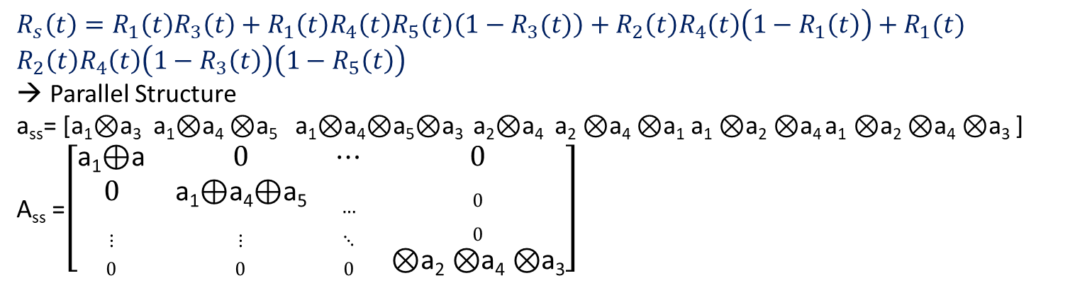
Jawaban No 1f
(10) Hitung nilai mean dan varians masa pakai jaringan (MTTF dan VTTF)
$R_{s}\left(t\right)=R_{1}\left(t\right)R_{3}\left(t\right)+R_{1}\left(t\right)R_{4}\left(t\right)R_{5}\left(t\right)\left(1−R_{3}(t)\right)+R_{2}\left(t\right)R_{4}\left(t\right)\left(1−R_{1}\left(t\right)\right)+R_{1}(t)$ $R_{2}\left(t\right)R_{4}\left(t\right)\left(1−R_{3}\left(t\right)\right)\left(1−R_{5}\left(t\right)\right)$
Parallel Structure
a_{ss}= [a₁⊗a₃ a₁⊗a₄ ⊗a₅ a₁⊗a₄⊗a₅⊗a₃ a₂⊗a₄ a₂ ⊗a₄ ⊗a₁ a₁ ⊗a₂ ⊗a₄ a₁ ⊗a₂ ⊗a₄ ⊗a₃ ]
A_{ss} =$\left[\begin{matrix}\text{a}\text{1}\text{⊕}\text{a} & 0 & ⋯ & 0 \\ 0 & \text{a}\text{1}\text{⊕}\text{a}\text{4}\text{⊕}\text{a}\text{5} & … & 0 \\ ⋮ & ⋮ & ⋱ & 0 \\ 0 & 0 & 0 & \text{⊗}\text{a}\text{2}\text{ ⊗}\text{a}\text{4}\text{ ⊗}\text{a}\text{3}\end{matrix}\right]$

Slide 12
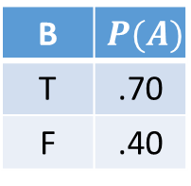
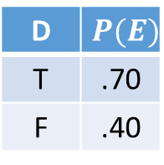
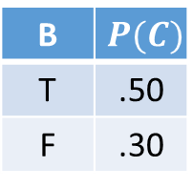
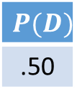
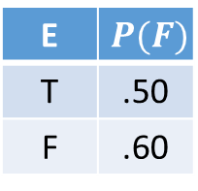
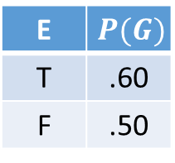
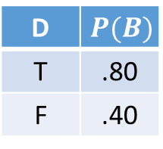
2. Untuk BN Tree Structure dibawah ini, tentukan
(10) Hitung probabilitasnya E terjadi bila diinformasikan B terjadi
(5) Hitung probabilitasnya E terjadi bila diinformasikan A dan B terjadi
(5) Hitung probabilitasnya E terjadi bila diinformasikan A dan D terjadi
(10) Cocokkan jawabanmu dengan hasil software yang dipakai untuk proyek 3
D
$$P(D)$$
.50
D | $$P(B)$$
T | .80
F | .40
D | $$P(E)$$
T | .70
F | .40
B
E
B | $$P(A)$$
T | .70
F | .40
A
C
F
G
E | $$P(G)$$
T | .60
F | .50
B | $$P(C)$$
T | .50
F | .30
E | $$P(F)$$
T | .50
F | .60

Slide 13
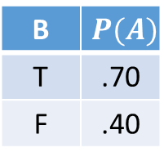
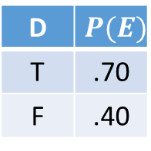
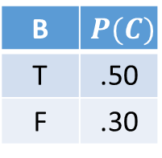
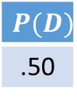
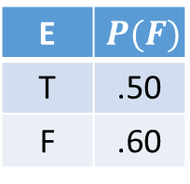
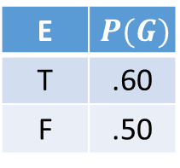
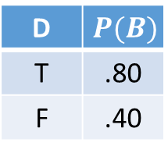
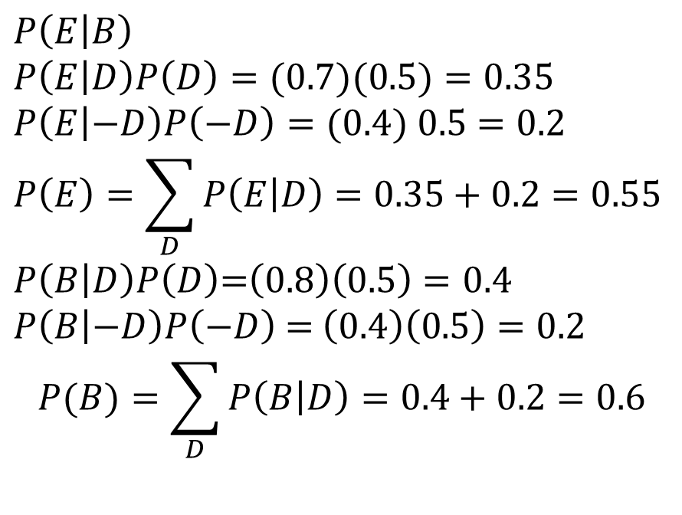
Jawaban No 2a
Hitung probabilitasnya E terjadi bila diinformasikan B terjadi
$$P\left(E | B\right)$$
$$P\left(E | D\right)P\left(D\right)=(0.7)(0.5)=0.35$$
$$P\left(E | −D\right)P\left(−D\right)=(0.4) 0.5=0.2$$
$$P\left(E\right)=\sum_{D}{P\left(E | D\right)=0.35+0.2}=0.55$$
$P\left(B | D\right)P\left(D\right)$=$\left(0.8\right)\left(0.5\right)=0.4$
$P\left(B | −D\right)P\left(−D\right)$ = $\left(0.4\right)\left(0.5\right)=0.2$
$$P(B)=\sum_{D}{P\left(B | D\right)=0.4+0.2=0.6}$$
$$P(D)$$
.50
D | $$P(B)$$
T | .80
F | .40
D
D | $$P(E)$$
T | .70
F | .40
B
E
B | $$P(A)$$
T | .70
F | .40
A
C
F
G
E | $$P(G)$$
T | .60
F | .50
B | $$P(C)$$
T | .50
F | .30
E | $$P(F)$$
T | .50
F | .60

Slide 14
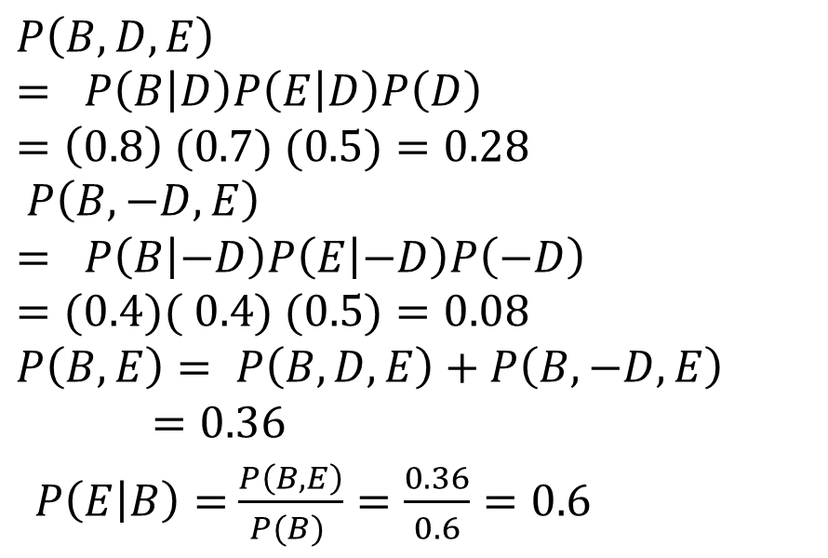
Jawaban No 2a
Hitung probabilitasnya E terjadi bila diinformasikan B terjadi
$$P\left(B,D,E\right)= P\left(B | D\right)P\left(E | D\right)P\left(D\right) =\left(0.8\right) (0.7) (0.5)=0.28$$
$P\left(B,−D,E\right)$
$$= P\left(B | −D\right)P\left(E | −D\right)P\left(−D\right)=(0.4)( 0.4) (0.5)=0.08$$
$P\left(B,E\right)= P\left(B,D,E\right)+$ $P\left(B,−D,E\right)$
$=0.36$
$P\left(E | B\right)=$ $\frac{P\left(B,E\right)}{P(B) }=\frac{0.36}{0.6}=0.6$
$$P(D)$$
.50
D | $$P(B)$$
T | .80
F | .40
D
D | $$P(E)$$
T | .70
F | .40
B
E
B | $$P(A)$$
T | .70
F | .40
A
C
F
G
E | $$P(G)$$
T | .60
F | .50
B | $$P(C)$$
T | .50
F | .30
E | $$P(F)$$
T | .50
F | .60

Slide 15
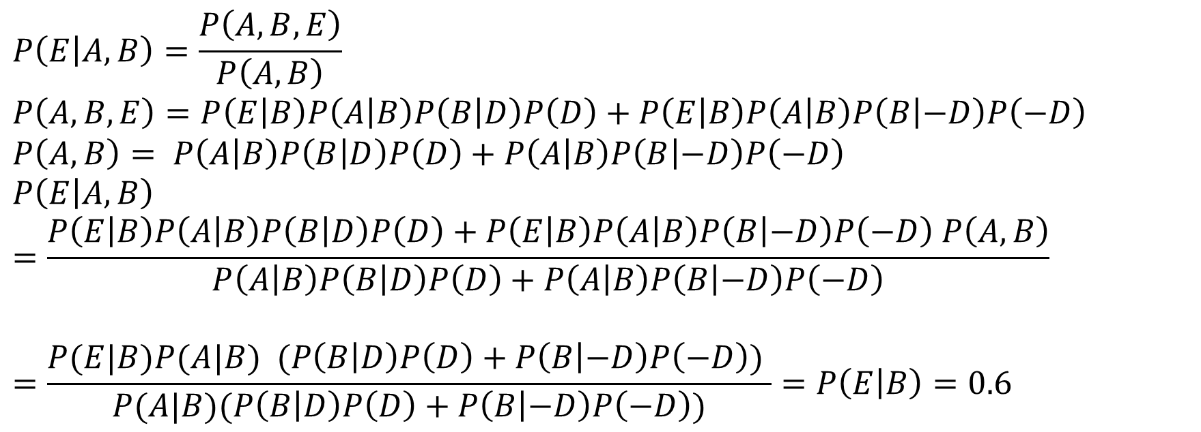
Jawaban No 2b
Hitung probabilitasnya E terjadi bila diinformasikan A dan B terjadi
$$P\left(E | A,B\right)=\frac{P\left(A,B,E\right)}{P\left(A,B\right)}$$
$$P\left(A,B,E\right)=P\left(E | B\right)P\left(A | B\right)P\left(B | D\right)P\left(D\right)+P\left(E | B\right)P\left(A | B\right)P\left(B | −D\right)P\left(−D\right)$$
$$P\left(A,B\right)= P\left(A | B\right)P\left(B | D\right)P\left(D\right)+P\left(A | B\right)P\left(B | −D\right)P\left(−D\right)$$
$$P\left(E | A,B\right)=\frac{P\left(E | B\right)P\left(A | B\right)P\left(B | D\right)P\left(D\right)+P\left(E | B\right)P\left(A | B\right)P\left(B | −D\right)P\left(−D\right) P\left(A,B\right)}{P\left(A | B\right)P\left(B | D\right)P\left(D\right)+P\left(A | B\right)P\left(B | −D\right)P\left(−D\right)}$$
$$=\frac{P(E|B)P(A|B) (P\left(B | D\right)P\left(D\right)+P\left(B | −D\right)P\left(−D\right)) }{P(A|B)(P\left(B | D\right)P\left(D\right)+P\left(B | −D\right)P\left(−D\right))}=P\left(E | B\right)=0.6$$

Slide 16
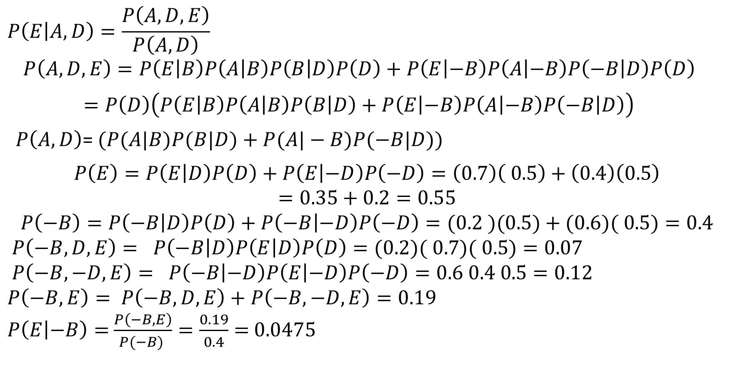
Jawaban No 2c
Hitung probabilitasnya E terjadi bila diinformasikan A dan D terjadi
$$P\left(E | A,D\right)=\frac{P\left(A,D,E\right)}{P\left(A,D\right)}$$
$$P\left(A,D,E\right)=P\left(E | B\right)P\left(A | B\right)P\left(B | D\right)P\left(D\right)+P\left(E | −B\right)P\left(A | −B\right)P\left(−B | D\right)P\left(D\right)$$
$$=P\left(D\right)\left(P\left(E | B\right)P\left(A | B\right)P\left(B | D\right)+P\left(E | −B\right)P\left(A | −B\right)P\left(−B | D\right)\right)$$
$P\left(A,D\right)$= $(P(A|B)P(B|D)+P(A|−B)P(−B|D))$
$$P\left(E\right)=P\left(E | D\right)P\left(D\right)+P\left(E | −D\right)P\left(−D\right)=\left(0.7\right)\left( 0.5\right)+\left(0.4\right)\left(0.5\right)$$
$$=0.35+0.2=0.55$$
$$P\left(−B\right)=P\left(−B | D\right)P\left(D\right)+P\left(−B | −D\right)P\left(−D\right)=(0.2 )(0.5)+(0.6)( 0.5)=0.4$$
$P\left(−B,D,E\right)= P\left(−B | D\right)P\left(E | D\right)P\left(D\right)=(0.2)( 0.7)( 0.5)=0.07$
$P\left(−B,−D,E\right)= P\left(−B | −D\right)P\left(E | −D\right)P\left(−D\right)=0.6 0.4 0.5=0.12$
$P\left(−B,E\right)= P\left(−B,D,E\right)+$ $P\left(−B,−D,E\right)=0.19$
$P\left(E | −B\right)=$ $\frac{P\left(−B,E\right)}{P(−B) }=\frac{0.19}{0.4}=$ 0.0475

Slide 17
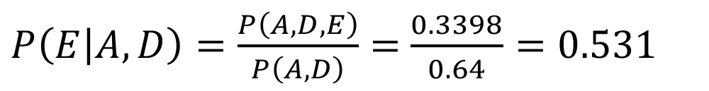
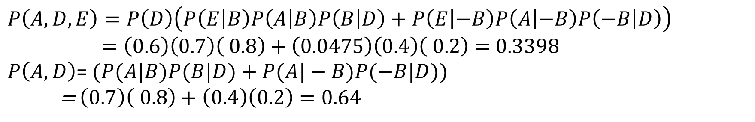
Jawaban No 2c
Hitung probabilitasnya E terjadi bila diinformasikan A dan D terjadi
$$P\left(A,D,E\right)=P\left(D\right)\left(P\left(E | B\right)P\left(A | B\right)P\left(B | D\right)+P\left(E | −B\right)P\left(A | −B\right)P\left(−B | D\right)\right)$$
$=\left(0.6\right)\left(0.7\right)\left( 0.8\right)+\left(0.0475\right)\left(0.4\right)\left( 0.2\right)=$ 0.3398
$P\left(A,D\right)$= $(P(A|B)P(B|D)+P(A|−B)P(−B|D))$
= $\left(0.7\right)\left( 0.8\right)+\left(0.4\right)\left(0.2\right)=0.64$
$P\left(E | A,D\right)=\frac{P\left(A,D,E\right)}{P\left(A,D\right)}=$ $\frac{0.3398}{0.64}=0.531$

Slide 18
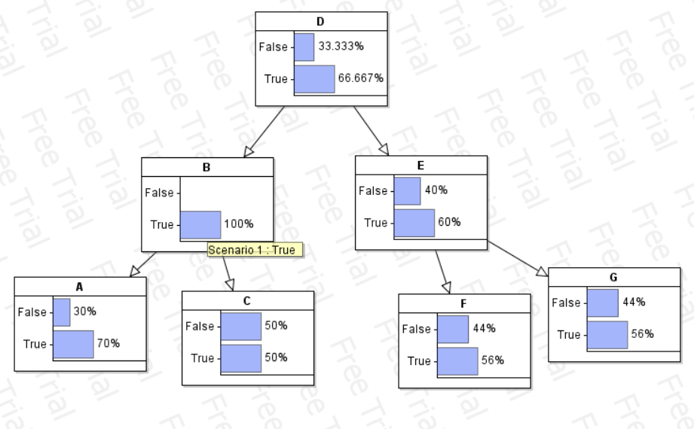
Jawaban No 2d
Cocokkan jawabanmu dengan hasil software yang dipakai untuk proyek 3
probabilitasnya E terjadi bila diinformasikan B terjadi
Perhitungan 0.6, Dengan Software 60%

Slide 19
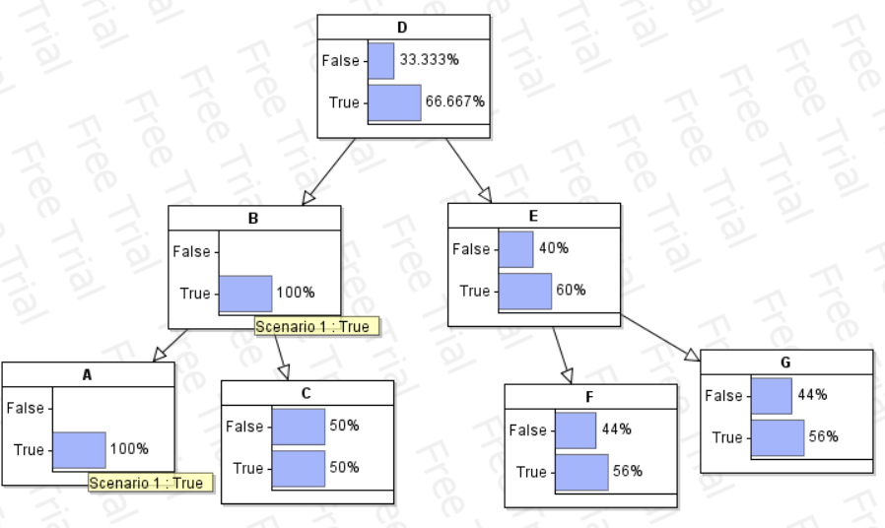
Jawaban No 2d
Cocokkan jawabanmu dengan hasil software yang dipakai untuk proyek 3
probabilitasnya E terjadi bila diinformasikan A dan B
Perhitungan 0.6, Dengan Software 60%

Slide 20
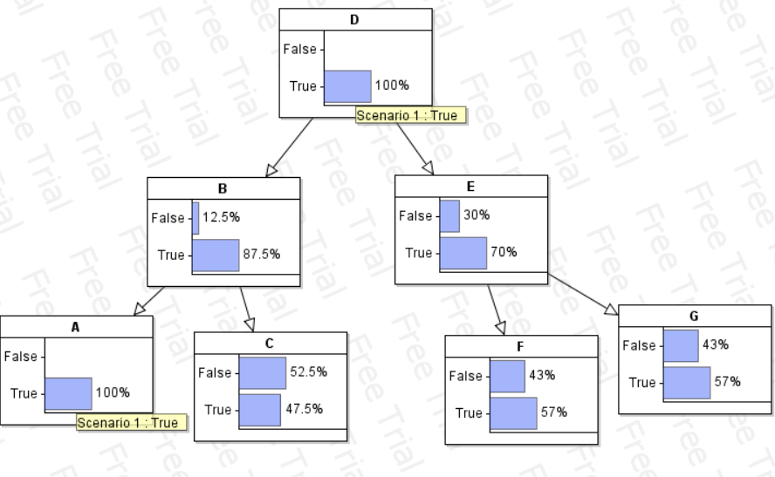
Jawaban No 2d
Cocokkan jawabanmu dengan hasil software yang dipakai untuk proyek 3
probabilitasnya E terjadi bila diinformasikan A dan D terjadi
Perhitungan 0.531, Dengan Software 70%

Slide 21
3. Untuk kasus berikut:
Bila jatuh, maka adik menangis
Bila mainannya hilang, maka adik menangis
Bila haus, maka adik menangis
Bila adik menangis, maka kakak berteriak memanggil ibu
Bila ada kecoa, maka kakak berteriak
(10) Nyatakan dalam bentuk BN
(10) Beri nilai probabilitas yang diperlukan dan sesuai dengan aturan untuk BN tersebut
(10) Berdasarkan angka-angka di jawaban b., tentukan probabilitasnya adik menangis karena jatuh bila diketahui kakak berteriak

Slide 22
Jawaban No 3a
Kehilangan Mainan (K)
Jatuh (J)
Haus (H)
Adek
Menangis (N)
Ada Kecoa (O)
Kakak Berteriak (B)
Memanggil Ibu (I)

Slide 23
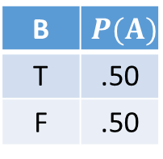
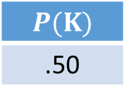
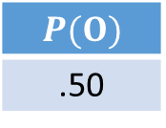
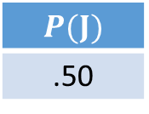

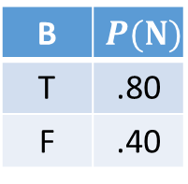
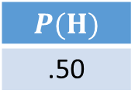
Jawaban No 3b
$$P(K)$$
.50
$$P(H)$$
.50
$$P(J)$$
.50
Kehilangan Mainan (K)
Jatuh (J)
Haus (H)
$$P(O)$$
.50
Adek
Menangis (N)
B | $$P(N)$$
T | .80
F | .40
Ada Kecoa (O)
Kakak Berteriak
Memanggil “lbu” (I)
B | $$P(I)$$
T | .80
F | .40
Kakak Berteriak
“aa” (A)
B | $$P(A)$$
T | .50
F | .50

Slide 24
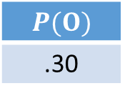
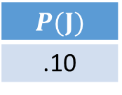
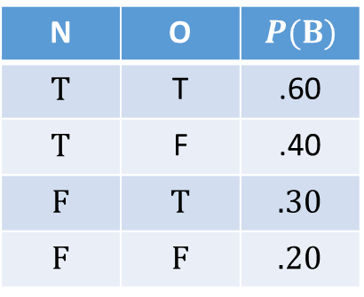
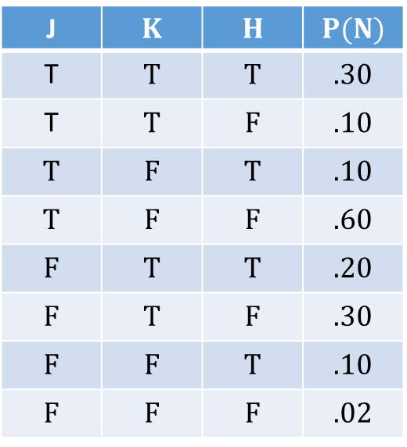
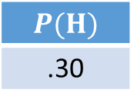
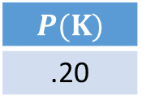
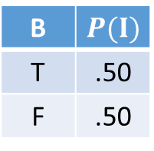
Jawaban No 3b
$$P(K)$$
.20
$$P(J)$$
.10
$$P(H)$$
.30
K
J | $$K$$ | $$H$$ | $$P(N)$$
T | T | T | .30
T | T | F | .10
T | F | T | .10
T | F | F | .60
F | T | T | .20
F | T | F | .30
F | F | T | .10
F | F | F | .02
J
H
$$P(O)$$
.30
N
O
B
I
N | O | $$P(B)$$
T | T | .60
T | F | .40
F | T | .30
F | F | .20
B | $$P(I)$$
T | .50
F | .50

Slide 25
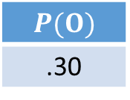
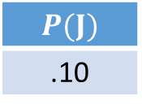
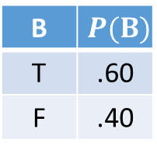

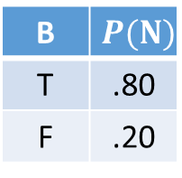
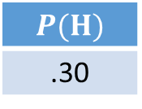



Jawaban No 3c
Probabilitas Adik Nangis Karena Jatuh dari Informasi Kakak berteriak P(N,J|B)
$P\left(N | B\right)=\frac{P(B|N) P\left(N\right)}{P\left(B\right)}=\frac{P(B|N) P\left(N\right)}{P\left(B\right)}$
$$P\left(N,J | B\right)=\frac{P(N,J,B)}{P\left(B\right)}$$
$P\left(N,J,B\right)=P(B$)
$$P\left(N\right)=\sum_{J}{\sum_{K}{\sum_{H}{P\left(N \right)=0.08+0.18+0.16+0.16+0.24+0.1}}}$$
$$=0.92$$
$$P(K)$$
.20
$$P(J)$$
.10
$$P(H)$$
.30
K
J
H
$$P\left(N,K\right)=P\left(N|K\right)P\left(K\right)$$ $=0.8 0.1=0.08$ | $P\left(N,−K\right)=$ $P\left(N|−K\right)P\left(−K\right)$ $=0.2 0.9=0.18$
$$P\left(N,J\right)=P\left(N|J\right)P\left(J\right)$$ $=0.8 0.2=0.16$ | $P\left(N,−J\right)=$ $P\left(N|−J\right)P\left(−K\right)$ $$=0.2 0.8=0.16$$
$$P\left(N,H\right) = P\left(N|H\right)P\left(H\right)$$ $$=0.8 0.3=0.24$$ | $$P\left(N,−H\right)= P\left(N|−H\right)P\left(−H\right)$$ $$=0.2 0.5=0.1$$
$$P(O)$$
.30
B | $$P(N)$$
T | .80
F | .20
N
O
B
I
B | $$P(B)$$
T | .60
F | .40
B | $$P(I)$$
T | .50
F | .50

